Slide 1
Software Design
Object Oriented Concepts

Slide 2
Object Orientation concept

Slide 3
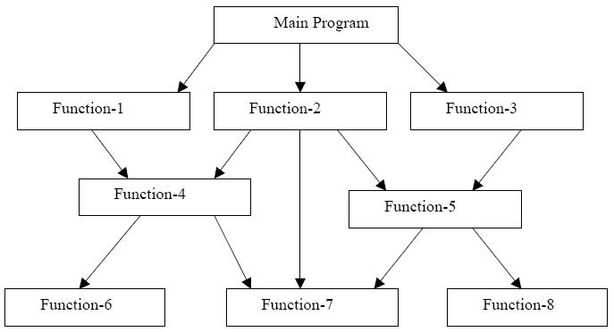
Procedural Programming
The problem is viewed as the sequence of things to be done such as reading, calculating and printing
The primary focus is on functions - the technique of hierarchical decomposition has been used to specify the tasks to be completed for solving a problem

Slide 4
Procedural Programming
Contd...
In a multi-function program, many important data items are placed as global so that they may be accessed by all the functions.
Global data are more vulnerable to an unintentional change by a function.
In a large program it is very difficult to identify what data is used by which function.
In case we need to revise an external data structure, we also need to revise all functions that access the data. This provides an opportunity for bugs to creep in.
Can not model real world problems very well - functions are action-oriented and do not really corresponding to the element of the problem

Slide 5
Procedural Programming
Characteristics
Emphasis is on doing things (algorithms).
Large programs are divided into smaller programs known as functions.
Most of the functions share global data.
Data move openly around the system from function to function.
Functions transform data from one form to another.
Employs top-down approach in program design.

Slide 6
Object Orientation
The Big Picture
The problem-solving techniques used in object-oriented paradigm is more closely models the way humans solve day-to-day problems
An object-oriented program is structured as community of interacting agents called objects.
  Each object has a role to play.
  Each object provides a service or performs an action that is used by other members of the community

Slide 7
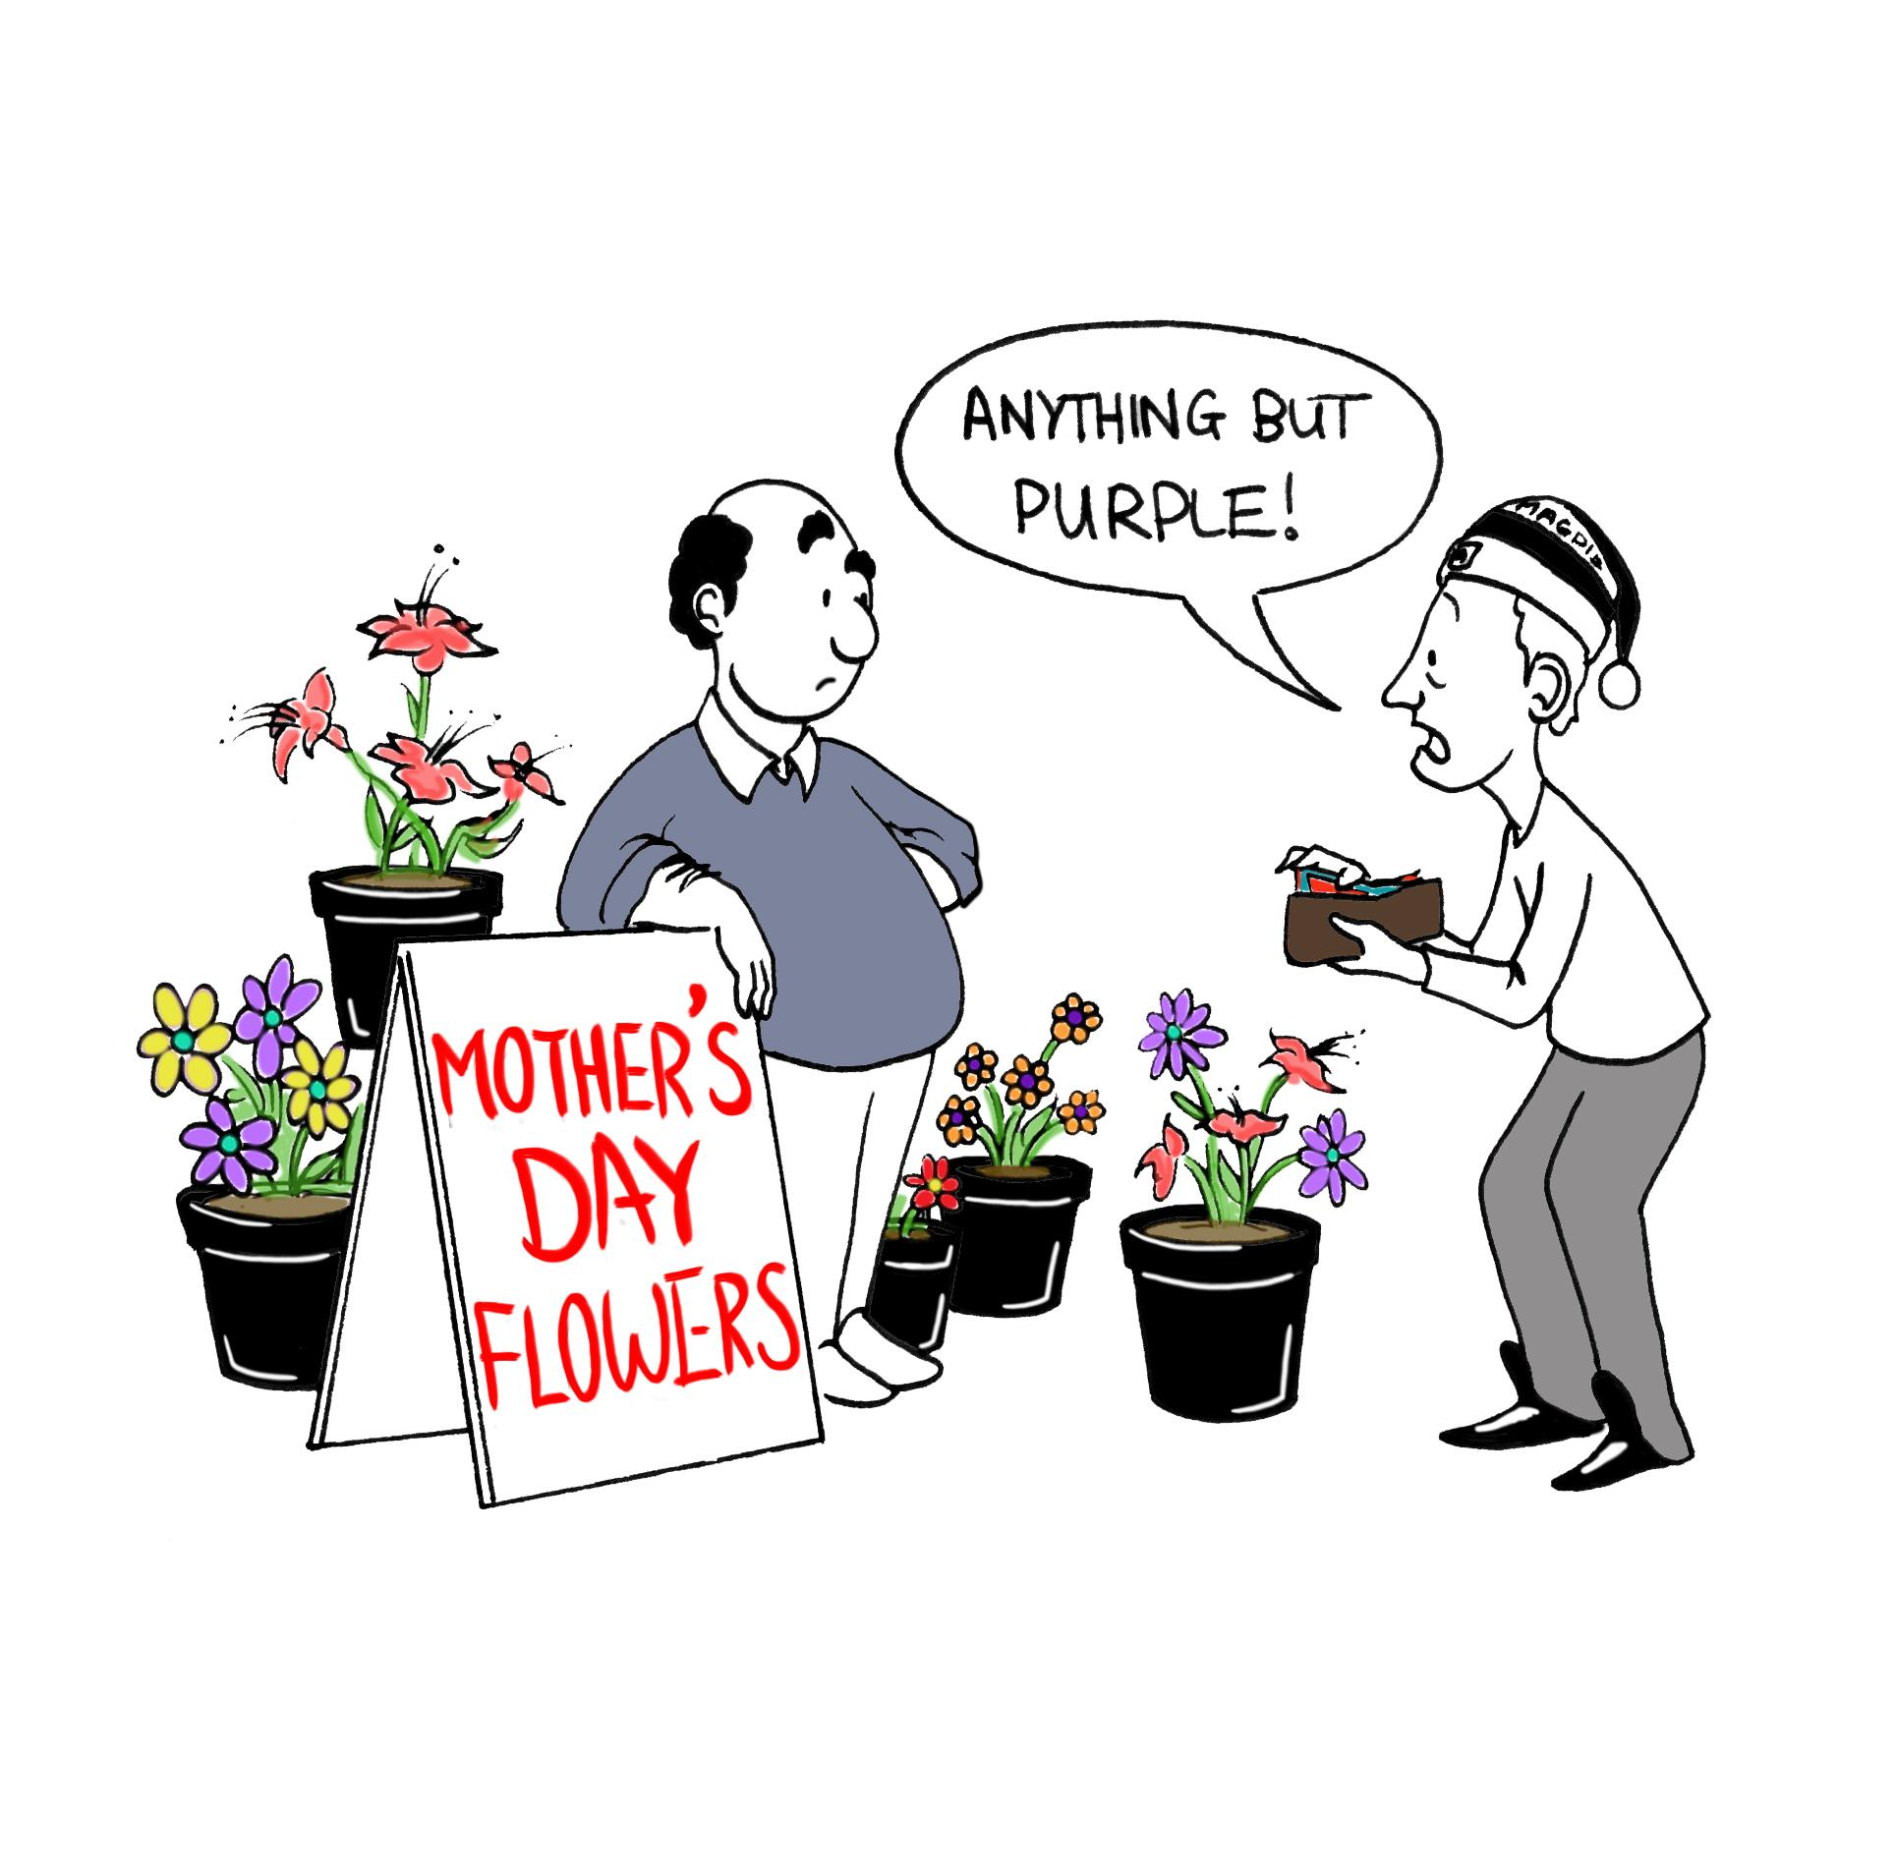
Object Orientation
An example
Suppose you wanted to send flowers to your Mother who lives in another city. To solve this problem you simply walk to your nearest florist run by, lets say, Raman. You tell Raman the kinds of flowers to send and the address to which they should be delivered. You can be assured that the flowers will be delivered.

Slide 8
Object Orientation
An example Contd...
Lets examine the mechanisms used to solve your problem
You first found an appropriate agent (Raman, in this case) and you passed to this agent a message containing a request.
It is the responsibility of Raman to satisfy the request.
There is some method (an algorithm or set of operations) used by Raman to do this.
You do not need to know the particular methods used to satisfy the request - such information is hidden from view.
This leads to our first conceptual picture of object-oriented programming:
“An object-oriented program is structured as community of interacting agents called objects. Each object has a role to play. Each object provides a service or performs an action that is used by other members of the community.”
Notes:
Off course, you do not want to know the details, but on investigation you may find that raman delivered a slightly different message to another florist in the city where your friend Suman lives. That florist then passes another message to a subordinate who makes the floral arrangement.The flowers, along with yet another message, is passed onto a delivery person and so on. The florists also has interactions with wholesalers who, in turn, had interactions with flower growers and so on.

Slide 9
Object Orientation
Messages and Responsibilities
Members of an object-oriented community make requests of each other.
Action is initiated in object-oriented programming by the transmission of a message to an agent (an object) responsible for the actions.
The message encodes the request for an action and is accompanied by any additional information (arguments/parameters) needed to carry out the request.
The receiver is the object to whom the message is sent. If the receiver accepts the message, it accepts responsibility to carry out the indicated action.
In response to a message, the receiver will perform some method to satisfy the request.
Notes:
Off course, you do not want to know the details, but on investigation you may find that raman delivered a slightly different message to another florist in the city where your friend Suman lives. That florist then passes another message to a subordinate who makes the floral arrangement.The flowers, along with yet another message, is passed onto a delivery person and so on. The florists also has interactions with wholesalers who, in turn, had interactions with flower growers and so on.

Slide 10
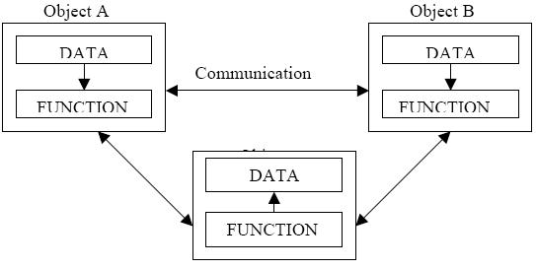
Object Oriented Paradigms
OOP treats data as a critical element in the program development and does not allow it to flow freely around the system.
It ties data more closely to the function that operate on it, and protects it from accidental modification from outside function.
OOP allows decomposition of a problem into a number of entities called objects and then builds data and function around these objects.
The data of an object can be accessed only by the function associated with that object
One object can communicate to another object using functions associated with that object (message passing)

Slide 11
Object Oriented Programming
Characteristics
Emphasis is on data rather than procedure.
Programs are divided into what are known as objects. Data structures are designed such that they characterize the objects.
Functions that operate on the data of an object are ties together in the data structure.
Data is hidden and cannot be accessed by external function.
Objects may communicate with each other through function.
New data and functions can be easily added whenever necessary.
Follows bottom up approach in program design.

Slide 12
Object and Class concept

Slide 13
Object
An object represents a tangible entity
Physical
Conceptual
Object are always not physical items and not visible items
Object orientation in computing is intended to thinking about programming closer to think about real world.
“What is an object in computer program => What is the object in real world ?”
Notes:
Off course, you do not want to know the details, but on investigation you may find that raman delivered a slightly different message to another florist in the city where your friend Suman lives. That florist then passes another message to a subordinate who makes the floral arrangement.The flowers, along with yet another message, is passed onto a delivery person and so on. The florists also has interactions with wholesalers who, in turn, had interactions with flower growers and so on.

Slide 14
Object : A more formal definition
An object is an entity that has a well-defined boundary. That is, the purpose of the object should be clear.
An object has three key components :
  Identity – Distinguishes one object than other
  Attributes – Information describes their current state
  Behaviour – Specific to an object
Object in a computer program are self contained. They are independent to each other.
Notes:
Off course, you do not want to know the details, but on investigation you may find that raman delivered a slightly different message to another florist in the city where your friend Suman lives. That florist then passes another message to a subordinate who makes the floral arrangement.The flowers, along with yet another message, is passed onto a delivery person and so on. The florists also has interactions with wholesalers who, in turn, had interactions with flower growers and so on.

Slide 15
An Object has State
The state of an object is one of the possible conditions that an object may exists in and it normally changes over time.
The state of an object is usually implemented by a set of properties call attributes. Most object can have multiple attributes
State of one object is independent than another
Notes:
Off course, you do not want to know the details, but on investigation you may find that raman delivered a slightly different message to another florist in the city where your friend Suman lives. That florist then passes another message to a subordinate who makes the floral arrangement.The flowers, along with yet another message, is passed onto a delivery person and so on. The florists also has interactions with wholesalers who, in turn, had interactions with flower growers and so on.

Slide 16
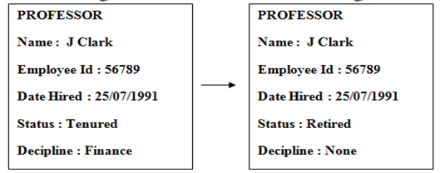
An Object has State
Contd...
Notes:
Off course, you do not want to know the details, but on investigation you may find that raman delivered a slightly different message to another florist in the city where your friend Suman lives. That florist then passes another message to a subordinate who makes the floral arrangement.The flowers, along with yet another message, is passed onto a delivery person and so on. The florists also has interactions with wholesalers who, in turn, had interactions with flower growers and so on.

Slide 17
An Object has Behaviour
Objects are intended to mirror the concepts that they are modelled for
Behaviour is specific to the type of the object
Behaviour determines how an object act and react to request from other objects
Object behaviour is represented by the operations that the objects can perform.
Notes:
Off course, you do not want to know the details, but on investigation you may find that raman delivered a slightly different message to another florist in the city where your friend Suman lives. That florist then passes another message to a subordinate who makes the floral arrangement.The flowers, along with yet another message, is passed onto a delivery person and so on. The florists also has interactions with wholesalers who, in turn, had interactions with flower growers and so on.

Slide 18
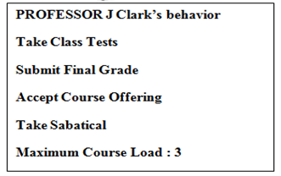
An Object has Behaviour
Contd...
Notes:
Off course, you do not want to know the details, but on investigation you may find that raman delivered a slightly different message to another florist in the city where your friend Suman lives. That florist then passes another message to a subordinate who makes the floral arrangement.The flowers, along with yet another message, is passed onto a delivery person and so on. The florists also has interactions with wholesalers who, in turn, had interactions with flower growers and so on.

Slide 19
An Object has an Identity
The term Identity means that objects are distinguished by their inherent existence and not by descriptive properties at they may have
The same concept holds true for objects. Although two objects may share the same state (attributes), the are separate, independent objects with their own unique identity
One object may contain another objects that, still they are separate.
Notes:
Off course, you do not want to know the details, but on investigation you may find that raman delivered a slightly different message to another florist in the city where your friend Suman lives. That florist then passes another message to a subordinate who makes the floral arrangement.The flowers, along with yet another message, is passed onto a delivery person and so on. The florists also has interactions with wholesalers who, in turn, had interactions with flower growers and so on.

Slide 20
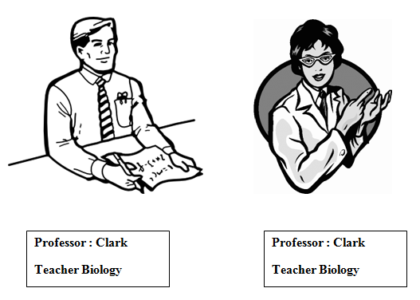
An Object has an Identity
Contd...
Notes:
Off course, you do not want to know the details, but on investigation you may find that raman delivered a slightly different message to another florist in the city where your friend Suman lives. That florist then passes another message to a subordinate who makes the floral arrangement.The flowers, along with yet another message, is passed onto a delivery person and so on. The florists also has interactions with wholesalers who, in turn, had interactions with flower growers and so on.

Slide 21
Computing Object
Objects in real world generally we consider objects those we can to see or touch.
But in computing we take it further – Date, Time, link-list, Bank Account, Event can be objects. These are well defined idea.
Object are always not physical items and not visible items
Notes:
Off course, you do not want to know the details, but on investigation you may find that raman delivered a slightly different message to another florist in the city where your friend Suman lives. That florist then passes another message to a subordinate who makes the floral arrangement.The flowers, along with yet another message, is passed onto a delivery person and so on. The florists also has interactions with wholesalers who, in turn, had interactions with flower growers and so on.

Slide 22
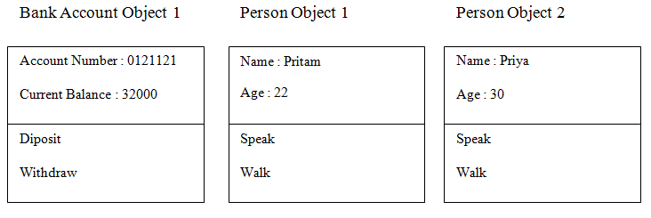
Computing Object
Contd...
Object in a computer program are self contained. They are independent to each other.
Like real world Object, they have identity, state and behaviour
Notes:
Off course, you do not want to know the details, but on investigation you may find that raman delivered a slightly different message to another florist in the city where your friend Suman lives. That florist then passes another message to a subordinate who makes the floral arrangement.The flowers, along with yet another message, is passed onto a delivery person and so on. The florists also has interactions with wholesalers who, in turn, had interactions with flower growers and so on.

Slide 23
How to find Object in computing
For those are new in Object Oriented Design, it could be potentially challenge to decide on objects in a compute program from the problem definition
It's easy to decide when a computer program need to objects like Car, Employee, document etc.
But while developing application like Event Management application, what about an Event ? Is an “Event” be an object ?
Notes:
Off course, you do not want to know the details, but on investigation you may find that raman delivered a slightly different message to another florist in the city where your friend Suman lives. That florist then passes another message to a subordinate who makes the floral arrangement.The flowers, along with yet another message, is passed onto a delivery person and so on. The florists also has interactions with wholesalers who, in turn, had interactions with flower growers and so on.

Slide 24
How to find Object in computing
Contd ...
Basic clue :
In the problem statement check for the the words those are noun (physical entity or idea or concept) and add “the” in front those - like the television, the car, the bank account, the time, the event
And verbs in the problem statement are behaviour associated to those Object – like flying, printing, exploding etc.
Notes:
Off course, you do not want to know the details, but on investigation you may find that raman delivered a slightly different message to another florist in the city where your friend Suman lives. That florist then passes another message to a subordinate who makes the floral arrangement.The flowers, along with yet another message, is passed onto a delivery person and so on. The florists also has interactions with wholesalers who, in turn, had interactions with flower growers and so on.

Slide 25
Where do the Objects come from ?
There is another word, that goes hand-in-hand with object - that word is Class
Entire point in OOD, is not about Objects, rather Class
In Computer program Class comes first, NOT the Object
Notes:
Off course, you do not want to know the details, but on investigation you may find that raman delivered a slightly different message to another florist in the city where your friend Suman lives. That florist then passes another message to a subordinate who makes the floral arrangement.The flowers, along with yet another message, is passed onto a delivery person and so on. The florists also has interactions with wholesalers who, in turn, had interactions with flower growers and so on.

Slide 26

Class
A Class describes what an Object will be, but it is not the object itself
A Class is a blue print – the detail description and definition
A Class is a description of a set of objects that share the same properties(attributes), behaviour(operations), kind of relationships, and semantics.
Notes:
Off course, you do not want to know the details, but on investigation you may find that raman delivered a slightly different message to another florist in the city where your friend Suman lives. That florist then passes another message to a subordinate who makes the floral arrangement.The flowers, along with yet another message, is passed onto a delivery person and so on. The florists also has interactions with wholesalers who, in turn, had interactions with flower growers and so on.

Slide 27
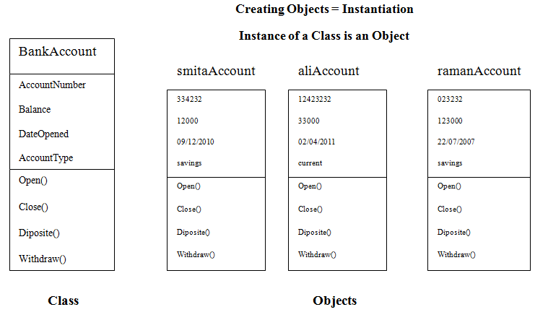
Class / Object
Notes:
Off course, you do not want to know the details, but on investigation you may find that raman delivered a slightly different message to another florist in the city where your friend Suman lives. That florist then passes another message to a subordinate who makes the floral arrangement.The flowers, along with yet another message, is passed onto a delivery person and so on. The florists also has interactions with wholesalers who, in turn, had interactions with flower growers and so on.

Slide 28
Existings Classes in OOP languages
Most OOP languages provide many pre-written generic classes at minimum : for example string, dates, file I/O, networking – so sometime you can start creating objects without writing classes
  C++ standard Library
  Java Class Library – 4000 classes available
  .Net standard Library – more than 4000 classes
  Ruby Standard Library
  Python Standard Library
But in non-trivial application, you still need to write Classes following few principle of OOP ...
Notes:
Off course, you do not want to know the details, but on investigation you may find that raman delivered a slightly different message to another florist in the city where your friend Suman lives. That florist then passes another message to a subordinate who makes the floral arrangement.The flowers, along with yet another message, is passed onto a delivery person and so on. The florists also has interactions with wholesalers who, in turn, had interactions with flower growers and so on.

Slide 29
Fundamental OOP concepts

Slide 30
Fundamental of OOP Concepts
Abstraction
Polymorphism
Inheritance
Encapsulation
Notes:
Off course, you do not want to know the details, but on investigation you may find that raman delivered a slightly different message to another florist in the city where your friend Suman lives. That florist then passes another message to a subordinate who makes the floral arrangement.The flowers, along with yet another message, is passed onto a delivery person and so on. The florists also has interactions with wholesalers who, in turn, had interactions with flower growers and so on.

Slide 31
Abstraction
Abstraction means focusing the essential quality of something, rather than one specific example.
It means automatically discard the unimportant and irrelevant.
Abstraction can be defined as :
“Any model that includes the most important, essential or distinguishing aspects of something while suppressing or ignoring less important, immaterial or diversionary details.”
Notes:
Off course, you do not want to know the details, but on investigation you may find that raman delivered a slightly different message to another florist in the city where your friend Suman lives. That florist then passes another message to a subordinate who makes the floral arrangement.The flowers, along with yet another message, is passed onto a delivery person and so on. The florists also has interactions with wholesalers who, in turn, had interactions with flower growers and so on.

Slide 32
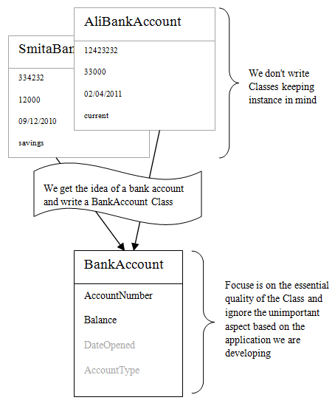
Abstraction
Example
Notes:
Off course, you do not want to know the details, but on investigation you may find that raman delivered a slightly different message to another florist in the city where your friend Suman lives. That florist then passes another message to a subordinate who makes the floral arrangement.The flowers, along with yet another message, is passed onto a delivery person and so on. The florists also has interactions with wholesalers who, in turn, had interactions with flower growers and so on.

Slide 33
Abstraction
Points to remember
Abstraction is as an external view of the object.
Abstraction allows us to manage complexity by concentrating on the essential characteristics of an entity that distinguishes it from all other kind of entities.
An abstraction is domain and perspective dependent. That is, what is important in one context, may not be in another.
In the context of OOP, abstraction of an object means its outside view provided by the interface. Note that the interface only tells WHAT the object can do, it does not says HOW it performs its work
Notes:
Off course, you do not want to know the details, but on investigation you may find that raman delivered a slightly different message to another florist in the city where your friend Suman lives. That florist then passes another message to a subordinate who makes the floral arrangement.The flowers, along with yet another message, is passed onto a delivery person and so on. The florists also has interactions with wholesalers who, in turn, had interactions with flower growers and so on.

Slide 34
Encapsulation
Encapsulation means hiding implementation detail from external world.
It is the idea of surrounding something, not just the keep the content together, but also to protect the content
Encapsulation can be defined as :
“The physical localization of features (e.g. properties, behaviors) into a single blackbox abstraction that hides their implementation ( and associated design decissions) behind a public interface”
Notes:
Off course, you do not want to know the details, but on investigation you may find that raman delivered a slightly different message to another florist in the city where your friend Suman lives. That florist then passes another message to a subordinate who makes the floral arrangement.The flowers, along with yet another message, is passed onto a delivery person and so on. The florists also has interactions with wholesalers who, in turn, had interactions with flower growers and so on.

Slide 35
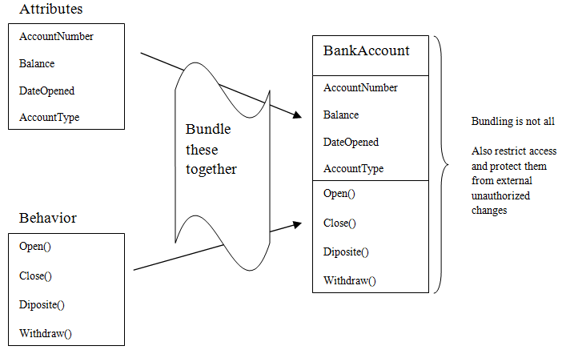
Encapsulation
Example
Notes:
Off course, you do not want to know the details, but on investigation you may find that raman delivered a slightly different message to another florist in the city where your friend Suman lives. That florist then passes another message to a subordinate who makes the floral arrangement.The flowers, along with yet another message, is passed onto a delivery person and so on. The florists also has interactions with wholesalers who, in turn, had interactions with flower growers and so on.

Slide 36
Encapsulation
Points to remeber
It is the approach of putting related things together
Distinguishes between interface and implementation – exposes interface, hides implementation
Encapsulation is often referred to as “information hiding”, making it possible for the clients to operate without knowing how the implementation fulfills the interface
It is possible to change the implementation without updating the clients as long as the interface is unchanged
Notes:
Off course, you do not want to know the details, but on investigation you may find that raman delivered a slightly different message to another florist in the city where your friend Suman lives. That florist then passes another message to a subordinate who makes the floral arrangement.The flowers, along with yet another message, is passed onto a delivery person and so on. The florists also has interactions with wholesalers who, in turn, had interactions with flower growers and so on.

Slide 37
Inheritance
Inheritance is the process of involving building classes upon an existing classes. So that additional functionality can be added.
Using inheritance the hierarchical relationships are established. Inheritance allows the reusability of an existing operations and extending the basic unit of a class without creating from the scratch.
Inheritance can be defined as :
“Inheritance is a way by which a newly defined Class inherits attributes and behaviors of an existing Class along with its own properties”
Notes:
Off course, you do not want to know the details, but on investigation you may find that raman delivered a slightly different message to another florist in the city where your friend Suman lives. That florist then passes another message to a subordinate who makes the floral arrangement.The flowers, along with yet another message, is passed onto a delivery person and so on. The florists also has interactions with wholesalers who, in turn, had interactions with flower growers and so on.

Slide 38
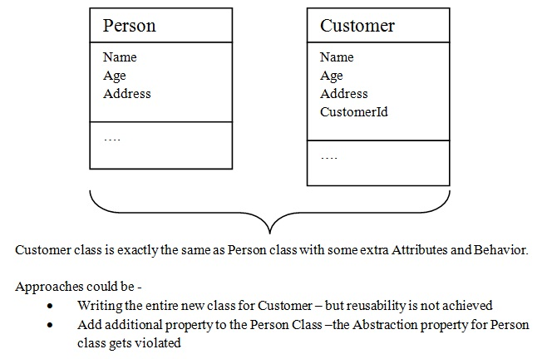
Inheritance
Example
Notes:
Off course, you do not want to know the details, but on investigation you may find that raman delivered a slightly different message to another florist in the city where your friend Suman lives. That florist then passes another message to a subordinate who makes the floral arrangement.The flowers, along with yet another message, is passed onto a delivery person and so on. The florists also has interactions with wholesalers who, in turn, had interactions with flower growers and so on.

Slide 39
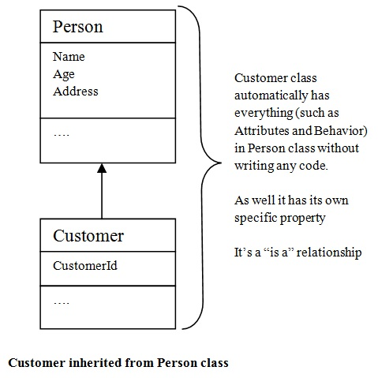
Inheritance
Example Contd...I
Notes:
Off course, you do not want to know the details, but on investigation you may find that raman delivered a slightly different message to another florist in the city where your friend Suman lives. That florist then passes another message to a subordinate who makes the floral arrangement.The flowers, along with yet another message, is passed onto a delivery person and so on. The florists also has interactions with wholesalers who, in turn, had interactions with flower growers and so on.

Slide 40
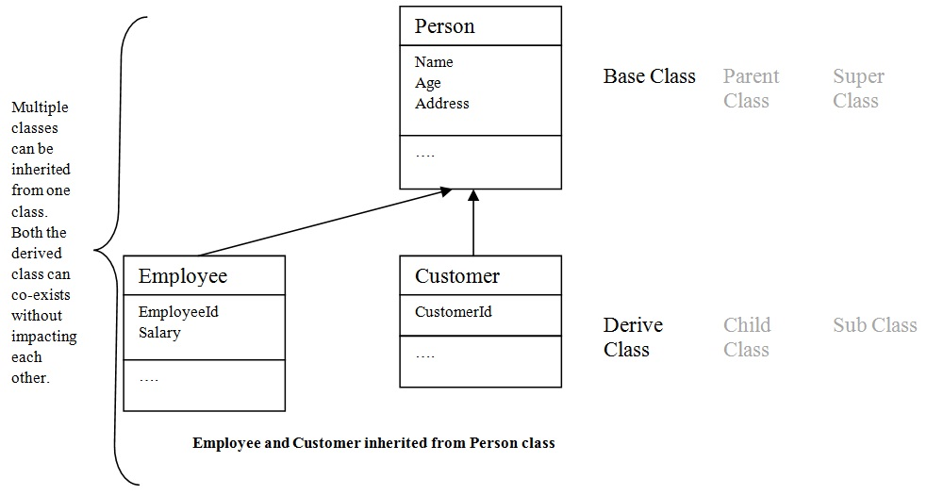
Inheritance
Example Contd...II
Notes:
Off course, you do not want to know the details, but on investigation you may find that raman delivered a slightly different message to another florist in the city where your friend Suman lives. That florist then passes another message to a subordinate who makes the floral arrangement.The flowers, along with yet another message, is passed onto a delivery person and so on. The florists also has interactions with wholesalers who, in turn, had interactions with flower growers and so on.

Slide 41
Inheritance
Points to remember
Its is a “is a” relation between Classes
Used for creating hierarchy of types
Its a code re-use mechanism
One Base Class can be inherited by multiple Derived Classes
One Derived Class can inherit properties from multiple Base classes – Multiple inheritance
Notes:
Off course, you do not want to know the details, but on investigation you may find that raman delivered a slightly different message to another florist in the city where your friend Suman lives. That florist then passes another message to a subordinate who makes the floral arrangement.The flowers, along with yet another message, is passed onto a delivery person and so on. The florists also has interactions with wholesalers who, in turn, had interactions with flower growers and so on.

Slide 42
Polymorphism
The Greek term polymorphism means “having many forms” - means being able to invoke different kinds of functionalities using the same interface”
Polymorphism can be defined as :
“Polymorphism is sharing a common interface for multiple types, but having different implementation for different types”
In OOP, polymorphism is a technique where objects of classes belonging to the same hierarchical tree (i.e. inherit from a common base class) and may possess interface bearing the same name but each having different behaviors
Notes:
Off course, you do not want to know the details, but on investigation you may find that raman delivered a slightly different message to another florist in the city where your friend Suman lives. That florist then passes another message to a subordinate who makes the floral arrangement.The flowers, along with yet another message, is passed onto a delivery person and so on. The florists also has interactions with wholesalers who, in turn, had interactions with flower growers and so on.

Slide 43
Polymorphism Analogy
A + B = ? What + sign do ?
For some language -
When A and B are Integer variable having value 6 and 7, it results 13.
The + sign behaves as Addition
When A and B are String variable having value “Hello” and “World”, it results “HelloWorld” .
The + sign behaves as Concatenation
It does automatically correct and different behavior based on the context of operation – this is the philosophy of Polymorphism
Notes:
Off course, you do not want to know the details, but on investigation you may find that raman delivered a slightly different message to another florist in the city where your friend Suman lives. That florist then passes another message to a subordinate who makes the floral arrangement.The flowers, along with yet another message, is passed onto a delivery person and so on. The florists also has interactions with wholesalers who, in turn, had interactions with flower growers and so on.

Slide 44
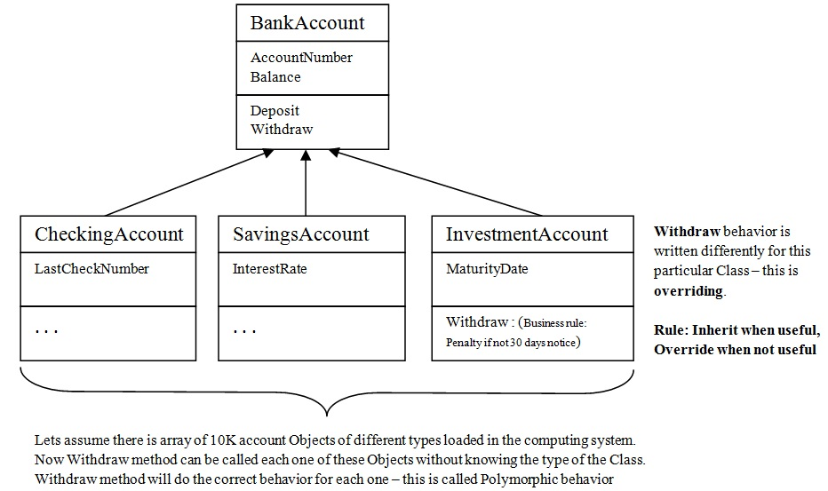
Polymorphism
Example
Notes:
Off course, you do not want to know the details, but on investigation you may find that raman delivered a slightly different message to another florist in the city where your friend Suman lives. That florist then passes another message to a subordinate who makes the floral arrangement.The flowers, along with yet another message, is passed onto a delivery person and so on. The florists also has interactions with wholesalers who, in turn, had interactions with flower growers and so on.

Slide 45
Polymorphism
Points to remember
Its the way of inheriting when useful, overriding when not useful
It allows automatically do the correct behavior even if we are working with many different forms
There are two kinds of Polymorphism
  Static Polymorphism
  Dynamic Polymorphism
Notes:
Off course, you do not want to know the details, but on investigation you may find that raman delivered a slightly different message to another florist in the city where your friend Suman lives. That florist then passes another message to a subordinate who makes the floral arrangement.The flowers, along with yet another message, is passed onto a delivery person and so on. The florists also has interactions with wholesalers who, in turn, had interactions with flower growers and so on.

